Slide 1
COURSE NAME: COURSE CODE:
ARTIFICIAL INTELLIGENCE
CIS 412
SYED TANGIM PASHA
LECTURER,
DEPARTMENT OF COMPUTING AND INFORMATION SYSTEM (CIS)
DAFFODIL INTERNATIONAL UNIVERSITY (DIU)
DHAKA,BANGLADESH

Slide 2
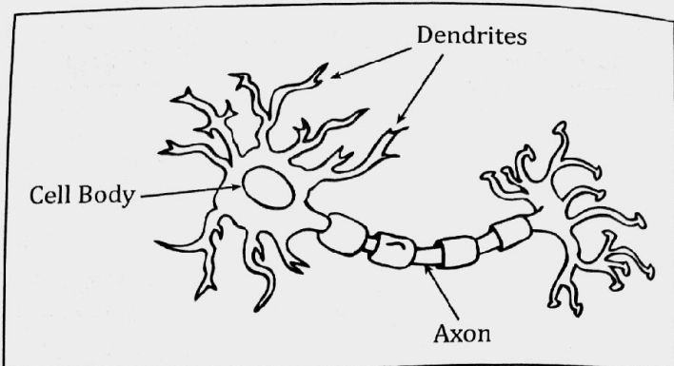
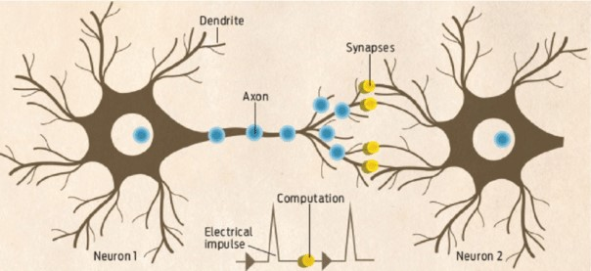
HUMAN BRAIN NEURON STRUCTURE
A neuron Has three main parts: Dendrites, Axon and Cell body.
Axon: The long, thin structure in which action potentials are generated; the transmitting part of the neuron. When Axon attach with the next Neuron’s dendrite is called Synapse.
Dendrite: The receiving part of the neuron. Dendrites receive synaptic inputs from axons, with the sum total of dendritic inputs determining whether the neuron will fire an action potential.
For Perceptron Axon works as Output and Dendrite works as Input.

Slide 3
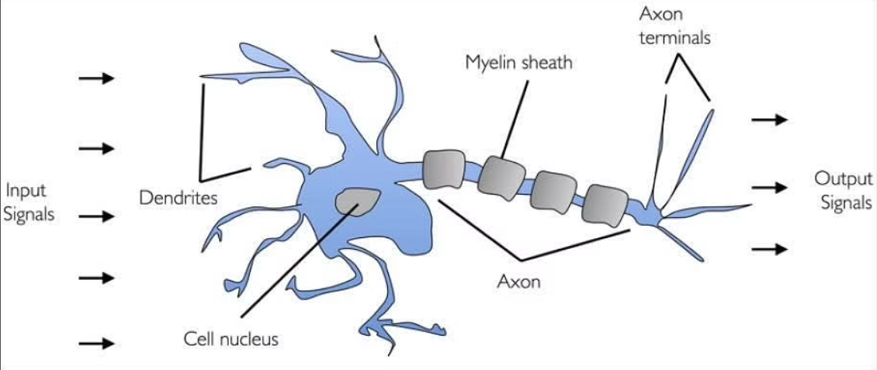
HUMAN BRAIN NEURON STRUCTURE

Slide 4
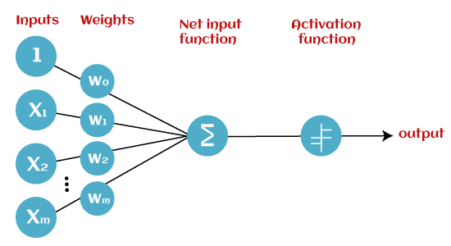
PERCEPTRON
Perceptron: Perceptron is a machine learning algorithm for supervised learning of various binary classification tasks.
It has four components: Input values, Weights & Bias, Net Sum, Activation function.

Slide 5
PERCEPTRON
Input layer: This is the primary component of Perceptron which accepts the initial data into the system for further processing. Each input node contains a real numerical value.
Weights & Bias: Weight parameter represents the strength of the connection between units. This is another most important parameter of perceptron components. Weight is directly proportional to the strength of the associated input neuron in deciding the output. Further, Bias can be considered as the line of intercept in a linear equation.
Activation Function: These are the final and important components that help to determine whether the neuron will fire or not. Activation Function can be considered primarily as a step function.

Slide 6
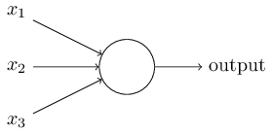
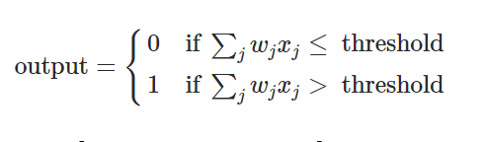
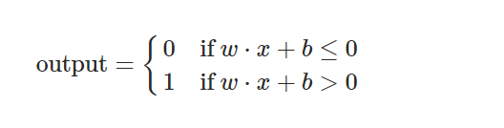
PERCEPTRON

Slide 7
OR GATE
+1
-10
X1 | X2 | hθ(x)
0 | 0 | g(-10)~0
0 | 1 | G(10)~1
1 | 0 | 1
1 | 1 | 1
X1
+20
hθ(x)
X2
+20
Figure X1 OR X2

Slide 8
AND GATE
+1
-30
X1 | X2 | hθ(x)
0 | 0 | g(-30)~0
0 | 1 | 0
1 | 0 | 0
1 | 1 | 1
X1
+20
hθ(x)
X2
+20
Figure X1 AND X2

Slide 9
NOT GATE
+1
+10
X1 | hθ(x)
0 | 1
1 | 0
hθ(x)
-20
X1
Figure X1 NOT X2

Slide 10
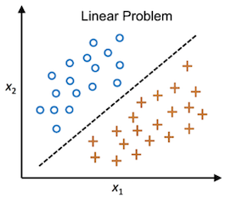
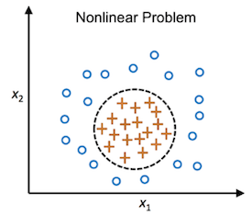
LIMITATIONS OF PERCEPTRON
Linear vs Non-Linear Data Separable

Slide 11
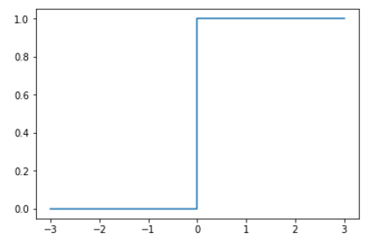
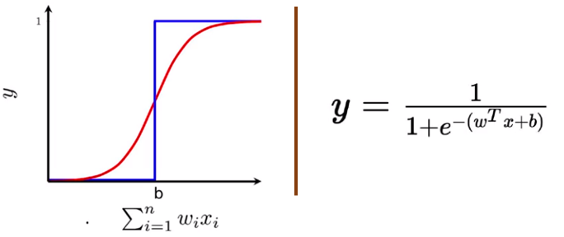
LIMITATIONS OF PERCEPTRON
Step Function vs Sigmoid Function
Fig: Step Function
Fig: Sigmoid Function

Slide 12
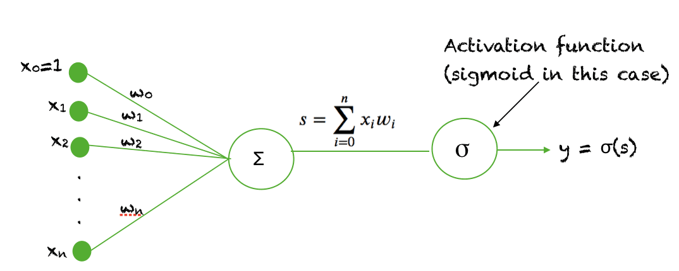
SIGMOID NEURON
Fig: Sigmoid Neuron

Slide 13
MULTI LAYER PERCEPTRON (MLP)
Multi Layer Perceptron (MLP): A Multi Layer Perceptron means it has a greater number of hidden layers.
It is also called feedforward Artificial Neural Network (ANN).
An MLP consists of at least three layers of nodes: Input layer, a Hidden layer, and an Output layer.
Except for the input nodes, each node is a neuron that uses a nonlinear activation function.
MLP utilizes a supervised learning technique called Backpropagation for training.
Its multiple layers and non-linear activation distinguish MLP from a linear perceptron.

Slide 14
QUESTION??
Is there any basic differences between MLP and ANN?
What is the main differenes between MLP and simple perceptron?
What is the differences between ANN (Artificial Neural Network) and DNN (Deep Neural Network)?

Slide 15
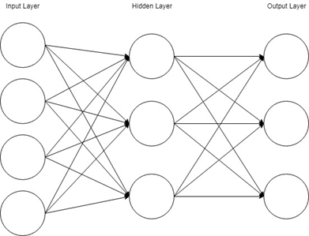
MULTI LAYER PERCEPTRON (MLP)

Slide 16
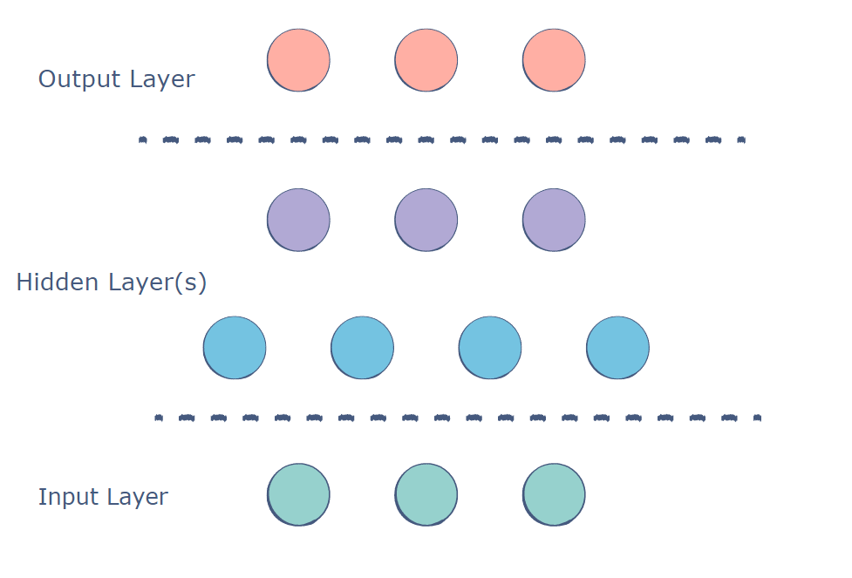
MLP LAYERS
Input Layer: This is the initial layer of the network which takes in an input which will be used to produce an output.
Hidden Layer(s): The network needs to have at least one hidden layer. The hidden layer perform computations and operations on the input data to produce something meaningful.
Output Layer: The neurons in this layer display a meaningful output.

Slide 17
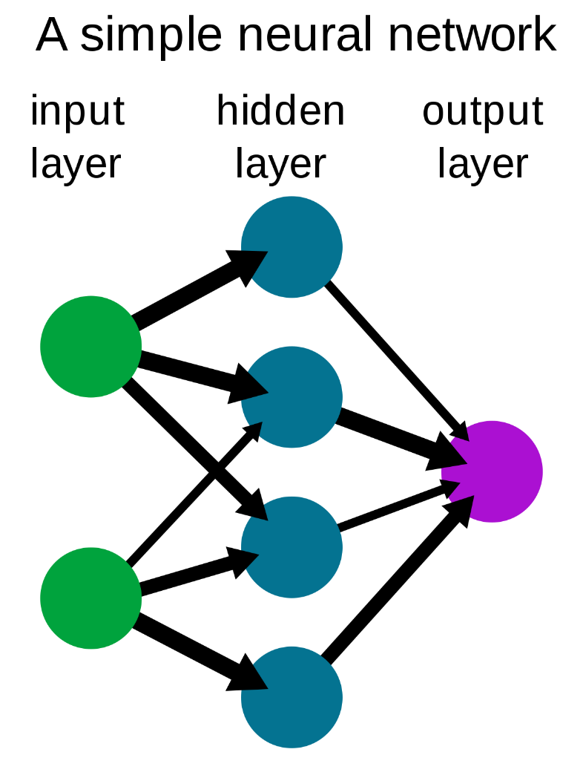
ARTIFICIAL NEURAL NETWORK
Artificial Neural Network (ANN): Artificial Neural Networks usually called Neural Networks (NNs) are computing systems inspired by the biological neural networks that constitute animal brains.

Slide 18
A SIMPLE HIDDEN LAYER CALCULATION
X1
X2
wT.x + b
σ(Z)
a=y_predict
X3
Z=wTx + b
a=σ(Z)

Slide 19
PARAMETERS & HYPERPARAMETERS
Hyperparameters:
Learning Rate (α)
Iterations
Hidden Layers (l)
Hidden Units
Activation Function
Momentum
Batch Size
Regularization (Drop out Layers)
Parameters:
W
b

Slide 20
ACTIVATION FUNCTION
Activation Functions:
Sigmoid Function/Logistic Function
Tanh Function (Hyperbolic Tangent)
ReLU Function
Leaky ReLU
Softmax Function
Activation Function: The Activation Function defines the output of a neuron/node given an input or set of input.

Slide 21
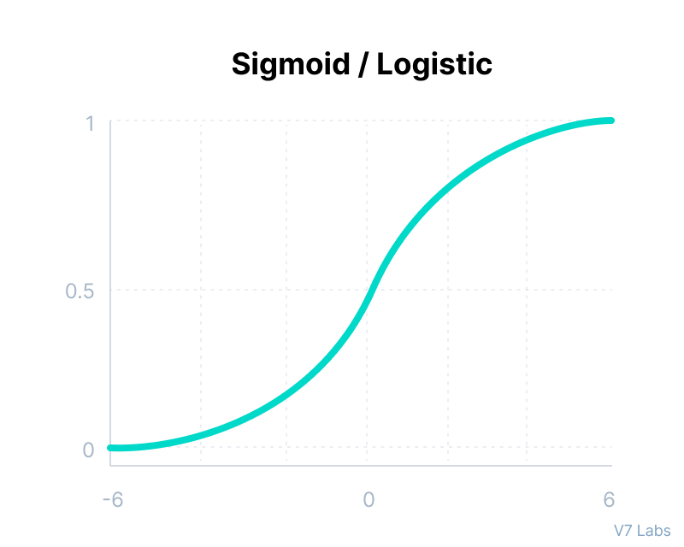
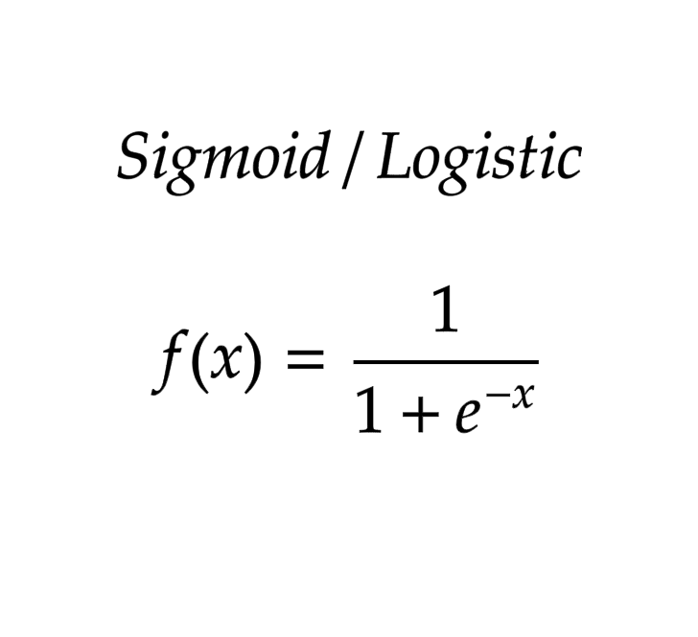
SIGMOID ACTIVATION FUNCTION
Sigmoid Function: This function takes any real value as input and outputs values in the range of 0 to 1.
The larger the input(more positive), the closer the output value will be to 1.0; whereas the smaller the input(more negative), the closer the output will be to 0.0

Slide 22
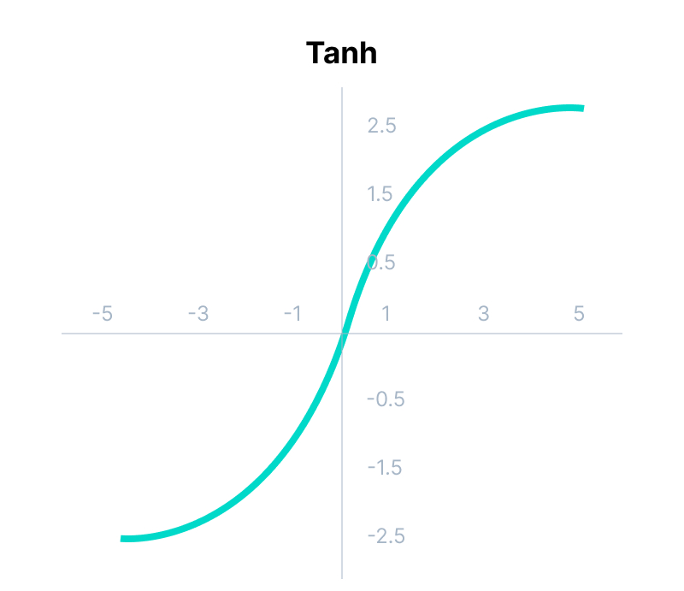
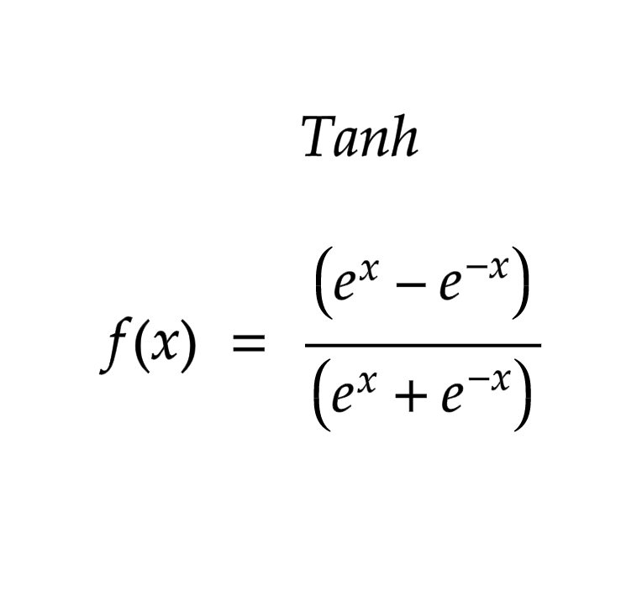
Tanh ACTIVATION FUNCTION
Tanh Function: Tanh function is very similar to the sigmoid/logistic activation function, and even has the same S-shape with the different in output range of -1 to 1.
In Tanh, the larger the input(more positive), the closer the output value will be to 1.0
Whereas the smaller the input(more negative), the closer the output will be to -1.0

Slide 23
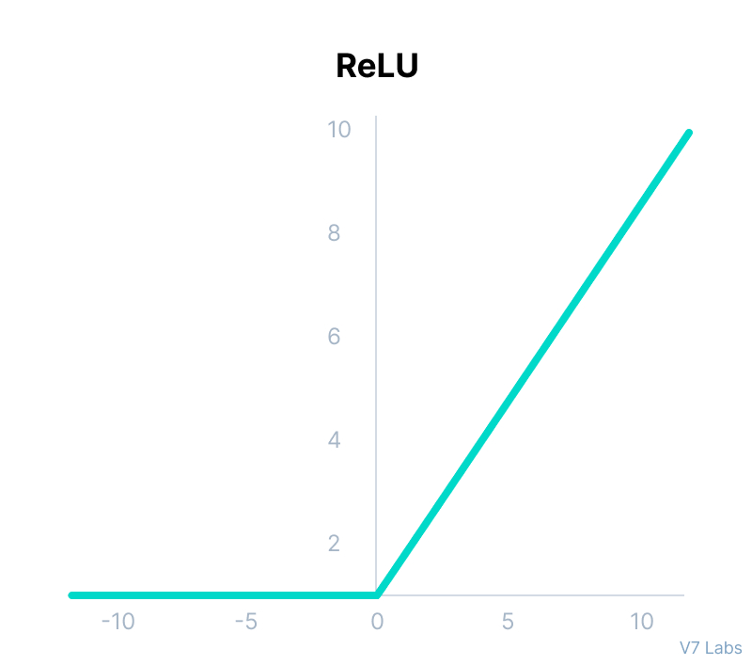
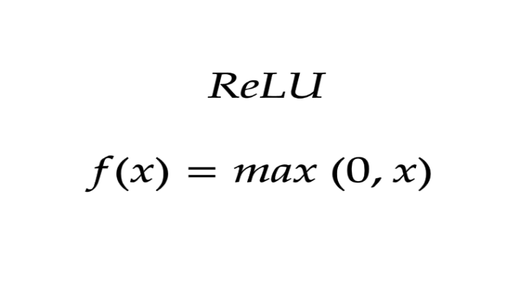
ReLU ACTIVATION FUNCTION
ReLU Function: ReLU stands for Rectified Linear Unit.
Although it gives an impression of a linear function, ReLU has a derivative function and allows for backpropagation while simultaneously making it computationally efficient.
The main catch here is that the ReLU function does not activate all the neurons at the same time.
The neurons will only be deactivated if the output of the linear transformation is less than 0.

Slide 24
QUESTION??
Why and When we should use ReLU instead of Sigmoid and Tanh Activation Function?

Slide 25
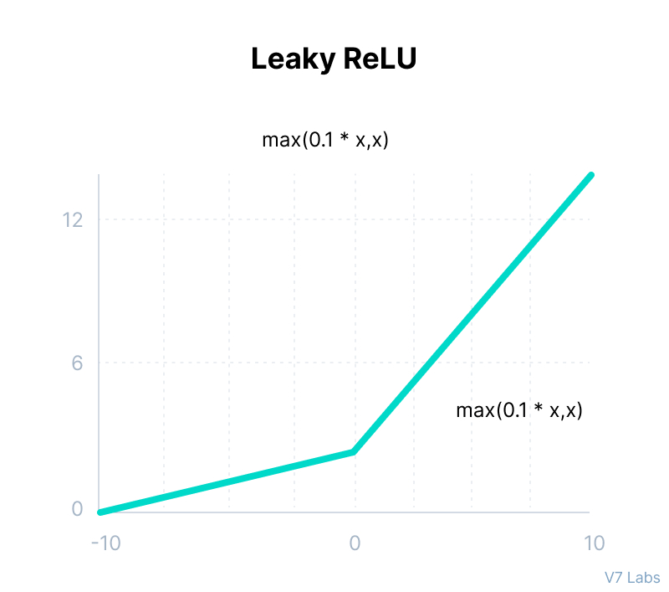
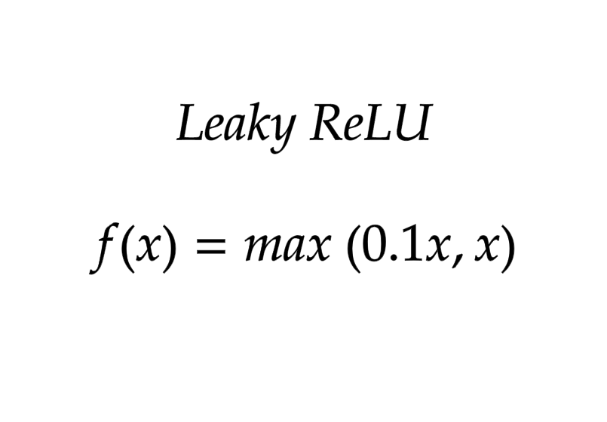
Leaky ReLU ACTIVATION FUNCTION
Leaky ReLU: Leaky ReLU is an improved version of ReLU function to solve the dying ReLU problem as it has a small positive slope in the negative area.

Slide 26
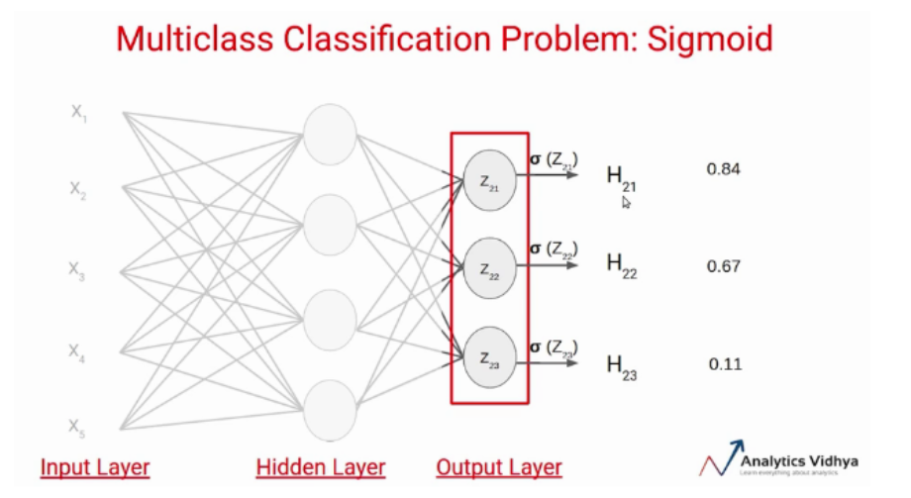
WHY NOT SIGMOID ???
We know that the sigmoid activation function gives the value between 0 and 1.
There are two problems in this case-
First, if we apply a threshold of say 0.5, this network says the input data point belongs to two classes.
Secondly, these probability values are independent of each other. That means, the probability that the data point belongs to class 1 does not take into account the probability of the other two classes.
This is the reason the sigmoid activation function is not preferred in multi-class classification problems.

Slide 27
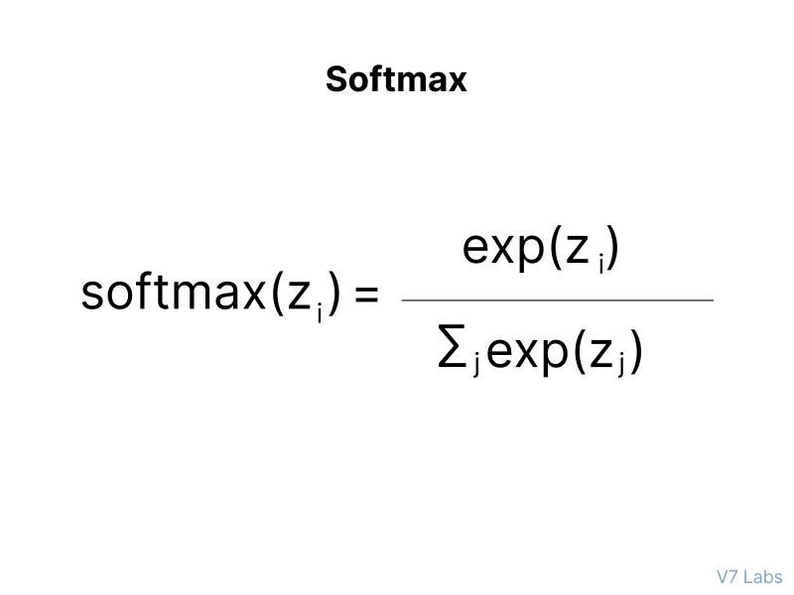
SOFTMAX ACTIVATION FUNCTION
Softmax Function: Softmax function calculates the probability of each class.
It is most commonly used as an activation function for the last layer of the neural network in the case of multi-class classification.

